Slide 1
LMS
LIQUID-MARKETS SOLUTIONS
THE POWER OF THE POSSIBLETM
Re-invigorating the Trading Stack
© 2020 Liquid-Markets-Holdings Inc. All rights reserved. Liquid-Markets Solutions, Naros.Card™, Naros.Hub and the LMS logo are trademarks of Liquid-Markets-Holdings Inc. or its affiliates.
Notes:
Alex Stein – Co-founder and head of Business Development at LMS
Previously I was a Managing Director at Two Sigma, a global systematic hedge fund. It was there I gained deep appreciation for the importance of fast and reliable market access – the focus of Liquid Market Solutions

Slide 2
LMS
Trading Stack Investment Yields Diminishing Returns
LIQUID-MARKETS SOLUTIONS
The Power of the Possible™
Today’s Trading Stack is Expensive
Equipment & People
Today’s Trading Stack is Limiting
Architecture Constraints/Multiple Hops/Unnecessary Latency
Today’s Trading Stack Saps Alpha
LMS Offers Brokers 50% Savings On Venue Access And Offers The Buyside New Sources of Alpha…
All You Have To Do Is Ask
A Solution Does Exist
© 2021 Liquid-Markets-Holdings Inc. All rights reserved.
Proprietary and Confidential – Not for Redistribution without Prior Written Consent

Slide 3
LMS
Reinvigorating the Entire Trading Stack
LIQUID-MARKETS SOLUTIONS
The Power of the Possible™
We Collapse the Stack
Network Interface to Broker DMA & Everything In-Between
Combined & Parallelized Functionality Drives Returns by Reducing Latency by 90% & Increasing Capacity by No Less Than 270%
We Use Proven FPGA Technologies in Innovative Ways
For 10+ Years We’ve Pioneered & Brought to Market Cutting Edge, Highly Scalable & Bullet-Proof Solutions to the Benefit of Institutional Investors, Securities Firms & the Broader Ecosystem
The Naros
Comprehensive Connectivity
Solution - Naros.CCS™ …
…Is Plug And Play For Brokers & The Buyside
>Returns - (<CapEx + <OpEx) = >ROI & >ROE
© 2021 Liquid-Markets-Holdings Inc. All rights reserved.
Proprietary and Confidential – Not for Redistribution without Prior Written Consent

Slide 4
LMS
The Network/Application Interface
Is
One of The Key Weak Links in the Trading Stack
LIQUID-MARKETS SOLUTIONS
The Power of the Possible™
The
“Last Mile”
In The
Trading Stack…
Is The Bottleneck
Inbound
Processing
Outbound
© 2021 Liquid-Markets-Holdings Inc. All rights reserved.
Proprietary and Confidential – Not for Redistribution without Prior Written Consent

Slide 5

LMS
LIQUID-MARKETS SOLUTIONS
The Power of tPossible™
Esoteric
& Expensive Techniques Deployed…
In Hopes Of
Extracting A
Competitive
Edge
“Firms aim to gain nanoseconds of advantage over rivals by using hollow-core fiber to convey data”
2020-12-15
© 2021 Liquid-Markets-Holdings Inc. All rights reserved.
Proprietary and Confidential – Not for Redistribution without Prior Written Consent

Slide 6


LMS
LIQUID-MARKETS SOLUTIONS
“…the bandwidth requirement may temporarily be significantly higher than the average…”
“…microbursts should be considered when calculating bandwidth requirements...”
The Power of the Possible™
But…
Where
Fiber
Ends…
Data
Throughput Challenges
Begin
2021-01-05
“…Cboe data will have microbursts…these microbursts will exceed the peak rates…”
2020-12-09
The Exchanges Are Warning Us…
© 2021 Liquid-Markets-Holdings Inc. All rights reserved.
Proprietary and Confidential – Not for Redistribution without Prior Written Consent

Slide 7
LMS
Leading, High-End NIC @10GbE
LIQUID-MARKETS SOLUTIONS
The Power of the Possible™
Architecture/Structure
Achieves <40% of Required Throughput
90th Pctl. T2T Latency: 927ns/∞¹
Designed for General-Purpose Use
Not Customizable or Upgradable
Prone to x86-64 Architecture Bottlenecks
See Appendix 2 for Naros.TaSR™ Results
Market
Data Rates
Typically Exceed
1000Mbps…
Significantly Surpassing
High-End NIC Capabilities
Motherboard
NIC
Rx Stack
T2T
CPU
PCIe
Tx Stack
¹ 927ns Through 805Mbps; fails at higher rates
Stressed Performance
>5000
4000
3000
Latency - Nanoseconds
2000
1000
100
1000
2000
3000
5000
7500
Constant Throughput Rate - Mbps
When Market Activity Spikes Your Trading Suffers
© 2021 Liquid-Markets-Holdings Inc. All rights reserved.
Proprietary and Confidential – Not for Redistribution without Prior Written Consent
Notes:
This one is for network card benchmarking

Slide 8
LMS
LMS Naros.Card™ (Hybrid) NIC @10GbE
LIQUID-MARKETS SOLUTIONS
The Power of the Possible™
Architecture/Structure
Achieves 99% of Required Throughput
90th Pctl. T2T Latency: 899ns/976ns¹
Special-Purpose FPGA-Enabled NIC
Designed w/Industry-Specific Logic
x86-64 Architecture-Driven Ceiling
See Appendix 3 for Naros.TaSR™ Results
Naros.Card™ (Hybrid FPGA) NIC…
Dramatically Expands
Capability &
Headroom
Motherboard
NIC
FPGA
Rx Stack
T2T
CPU
PCIe
Tx Stack
¹ 899ns Through 1000Mbps; 976ns Through 3000Mbps
Stressed Performance
>5000
4000
3000
Latency - Nanoseconds
2000
1000
100
1000
2000
3000
5000
7500
Constant Throughput Rate - Mbps
Empowers Your Strategies To Maximize Value In Active Markets
© 2021 Liquid-Markets-Holdings Inc. All rights reserved.
Proprietary and Confidential – Not for Redistribution without Prior Written Consent
Notes:
This one is for network card benchmarking

Slide 9
LMS
LMS Naros.Card™ (Full-FPGA) NIC @10GbE
LIQUID-MARKETS SOLUTIONS
The Power of the Possible™
Architecture/Structure
Achieves 100% of Required Throughput
90th Pctl. T2T Latency: 141ns
Special-Purpose FPGA-Enabled NIC
Designed w/Industry-Specific Logic
x86-64 Dependency Eliminated
See Appendix 4 for Naros.TaSR™ Results
Motherboard
NIC
FPGA
Naros.Card™
(Full-FPGA)…
Eliminates Constraints &
Massively Empowers Processing
Rx Stack
CPU
T2T
PCIe
Tx Stack
Stressed Performance
>5000
4000
3000
Latency - Nanoseconds
2000
1000
100
1000
2000
3000
5000
7500
Constant Throughput Rate - Mbps
Unleashes Strategies to Generate Alpha
© 2021 Liquid-Markets-Holdings Inc. All rights reserved.
Proprietary and Confidential – Not for Redistribution without Prior Written Consent
Notes:
This one is for network card benchmarking

Slide 10
LMS
10GbE – Exchange Demand vs NIC Capability
LIQUID-MARKETS SOLUTIONS
The Power of the Possible™
Naros.Card™ (Full FPGA)
Fully Performant to 7500Mbps
90th Pctl. T2T Latency: 141ns
Naros.Card™ (Hybrid FPGA)
Performant up to 3000Mbps
90th Pctl. T2T Latency: 899ns
Leading, High-End NIC
Non-Performant from 810Mbps
90th Pctl. T2T Latency: 927ns
The
Choice Is
Clear…
Naros.Card™ Prevents
Dropped Packets
While Accelerating Performance
7,500Mbps
^{Capacity Headroom}
3,000Mbps
^{Capacity Deficit}
805Mbps
Exchange Market Data Burst Rate
Burst Data Souce: NYSE, Nasdaq, Cboe
© 2021 Liquid-Markets-Holdings Inc. All rights reserved.
Proprietary and Confidential – Not for Redistribution without Prior Written Consent
Notes:
This one is for network card benchmarking

Slide 11
LMS
Collapsing the Trading Stack into Itself
LIQUID-MARKETS SOLUTIONS
The Power of the Possible™
Multi-Function Device Eliminates Disparate Single-Function Devices Including the Separate & Distinct Broker DMA Layer
Industry-Leading Network Stack & PCIe Logic Redefines The Possible
Implementation In-Parallel w/Network Stack & PCIe Logic Results in Zero Effective Latency
Encrypted Logic Guarantees Adherence to Regulatory Dictates
Trading Server
The Naros
Comprehensive Connectivity
Solution - Naros.CCS™ …
Accelerates Each
Component Of
The Trading Stack
With NIC
Naros.CardTM
RX
TX
Exchange
(Optional) Broker Input
Naros.CCSTM
Trading
Market Data Parsing
Trading
Strategy Processing
Trading
Validation & Risk Checks
Kernel Bypass &
PCie & Network Stack
(Optional) Broker
Validation & Risk Checks
OSI Layer 2/3/4 Expanded Functionality
Regulatorily Compliant Multi-Function FPGA Solution
Collapses Latency
© 2021 Liquid-Markets-Holdings Inc. All rights reserved.
Proprietary and Confidential – Not for Redistribution without Prior Written Consent
Notes:
So what is possible? CLICK
For investors, removing bottlenecks and reducing end to end latency to under 1000ns
Embracing simple plug and play solutions
And for the global banks, saving $50M pa while delivering the best of breed solution
Transition: So what really matters in terms of market connectivity? CLICK

Slide 12
LMS
LMS Naros.Card™ Deployment Options
LIQUID-MARKETS SOLUTIONS
Hybrid FPGA
The Power of the Possible™
Motherboard
NIC
Naros.Card Fully Manages:
OE & MD Sessions
Market Data Parsing
A/B Line Arbitrage
Pre-Trade Risk Checks
Message Validation
Supports Software-Based & Hardware-Based Strategies
Tick-to-Trade (FIFO):
942ns for Software Strategies
178ns for Hardware Strategies
FPGA
RX
Rx Stack
App
CPU
TX
The Naros
Comprehensive Connectivity
Solution - Naros.CCS™ …
Total
Flexibility
Meets
Your
Needs
PCIe
Tx Stack
Full-FPGA
Motherboard
NIC
FPGA
RX
Rx Stack
App
CPU
TX
App
PCIe
Tx Stack
Full-FPGA w/Daughter
FPGA Board
FPGA
App
Motherboard
MD Module
OE Module
App
CPU
Ribbon
Cable
PCIe
FPGA Board
FPGA
RX
Rx Stack
TX
Tx Stack
© 2021 Liquid-Markets-Holdings Inc. All rights reserved.
Proprietary and Confidential – Not for Redistribution without Prior Written Consent
Notes:
So what is possible? CLICK
For investors, removing bottlenecks and reducing end to end latency to under 1000ns
Embracing simple plug and play solutions
And for the global banks, saving $50M pa while delivering the best of breed solution
Transition: So what really matters in terms of market connectivity? CLICK

Slide 13
LMS
The Trading Stack – Bottom to Top
LIQUID-MARKETS SOLUTIONS
The Power of the Possible™
 |  |  | Current Practice | Inventing the Future⁶
 |  |  | Software (x86-64) | Naros.Card (Hybrid) | Naros.Card (Full FPGA)
Trading Stack | Internal |  | CPU Cores Diverted | CPU Cores Reclaimed | CPU Dependency Ended
 |  |  | 600ns to 1600ns | 0ns⁵ | 0ns⁵
 |  |  | 927ns <= 805Mbps¹ | 899ns <= 1000Mbps² | 141ns <= 7500Mbps
 |  |  | 800ns to 2200ns | 32ns | 32ns
 |  |  | Native Protocol | Custom API^{3a} | Custom API^{3b}
 | External |  | 350ns^{4a} to 1200ns^{4b} | 0ns⁵ | 0ns⁵
 |  |  | 800ns to 3600ns | 0ns⁵ | 0ns⁵
Total Latency |  | Total | 3827ns to 9527ns | 931ns | 173ns
Trading
Strategy Processing
Transforming
The
Trading
Stack…
Captures Alpha
& Cuts OpEx
Incrementally Or
At Once
Trading
Validation & Risk Checks
Kernel Bypass &
PCie & Network Stack
Trading
Market Data Parsing
Trading
Exchange Communication
Broker
Validation & Risk Checks
OSI Layer 2/3/4 Expanded Functionality
¹ Non-performant @ 810Mbps and above – insufficient to handle 60%+ of typical market data bursts ² 976ns <= 3000Mbps – sufficient to handle 99%+ of typical market data bursts ³ a) Reduces message size by 50%+ (depending on protocol) significantly improving PCIe transfer; b) PCIe transfer eliminated ⁴ As Claimed: a) Fusion Raptor; b) Fixnetix i-Execute ⁵ Conducted in-parallel with network stack functions resulting in zero practical/effective latency ⁶ US Patents 9,501,795, 10,269,071, 10,868,707, 10,880,211; Others Pending
How Much Will You & Your Broker Profit?
© 2021 Liquid-Markets-Holdings Inc. All rights reserved.
Proprietary and Confidential – Not for Redistribution without Prior Written Consent
Notes:
So what is possible? CLICK
For investors, removing bottlenecks and reducing end to end latency to under 1000ns
Embracing simple plug and play solutions
And for the global banks, saving $50M pa while delivering the best of breed solution
Transition: So what really matters in terms of market connectivity? CLICK

Slide 14
LMS
Naros.CCS™ Accelerates All Aspects of the Trading Stack
LIQUID-MARKETS SOLUTIONS
The Power of the Possible™
Naros.Net™
Industry-Leading Network Stack, PIO/DMA PCIe Transfer & Kernel Bypass
Plug & Play Application
Significantly Reduces Latency and Increases Capacity
Naros.Parse™
Market Data Parsing and A/B Line Arbitrage
Reduces Latency by 100s of Nanoseconds
Naros.TradeCheck™
Order Validation and Risk Check – Offload to FPGA
Reduces Latency by 100s to 1000s of nanoseconds
Naros.BrokerCheck™
Order Validation, Risk & Credit Check in FPGA
Eliminates Separate Inline Broker “PTRC” Systems
Reduces Latency by 100s to 1000s of nanoseconds
N.B. All services operate in-parallel w/transmit stack
The Naros.CCS™ Unleashes Alpha…
Where Do You Want To Harvest Alpha First?
© 2021 Liquid-Markets-Holdings Inc. All rights reserved.
Proprietary and Confidential – Not for Redistribution without Prior Written Consent
Notes:
So what is possible? CLICK
For investors, removing bottlenecks and reducing end to end latency to under 1000ns
Embracing simple plug and play solutions
And for the global banks, saving $50M pa while delivering the best of breed solution
Transition: So what really matters in terms of market connectivity? CLICK

Slide 15
LMS
Deployment Is As Easy as A, B, C, D
LIQUID-MARKETS SOLUTIONS
The Power of the Possible™
Naros.CCS™ Is Delivered Via A Special-Purpose FPGA-Enabled card…
Getting Started
Is Fast And Easy
Install API and Code to API
Replace Antiquated NIC with Naros.Card™
Connect Fiber Directly to Exchange Uplinks
Receive Market Data and Trade
Naros.CCS™ - Harvesting Alpha Has Never Been Easier
© 2021 Liquid-Markets-Holdings Inc. All rights reserved.
Notes:
So what is possible? CLICK
For investors, removing bottlenecks and reducing end to end latency to under 1000ns
Embracing simple plug and play solutions
And for the global banks, saving $50M pa while delivering the best of breed solution
Transition: So what really matters in terms of market connectivity? CLICK

Slide 16
LMS
LIQUID-MARKETS SOLUTIONS
The Power of the Possible™
Appendices
© 2021 Liquid-Markets-Holdings Inc. All rights reserved.
Proprietary and Confidential – Not for Redistribution without Prior Written Consent
Notes:
So what is possible? CLICK
For investors, removing bottlenecks and reducing end to end latency to under 1000ns
Embracing simple plug and play solutions
And for the global banks, saving $50M pa while delivering the best of breed solution
Transition: So what really matters in terms of market connectivity? CLICK

Slide 17
LMS
Nanosecond Accuracy Profile Testing & Measurement¹
LIQUID-MARKETS SOLUTIONS
The Power of the Possible™
Consistent Interval Transmission To
Create…
Realistic
Burst & Stress
Testing
of the
Network/Application Interface
10GbE Link Speed
64Byte UDP Payload
880bit Layer 2 Frame
1 Million Frames
Target Throughput Rate
RX + TX + T2T Application
Layer 2 SOF to SOF FIFO
¹ See LMS Naros.TaSR (Testing and Simulation Rig) Product Sheet for Details
© 2021 Liquid-Markets-Holdings Inc. All rights reserved.
Proprietary and Confidential – Not for Redistribution without Prior Written Consent
Notes:
So what is possible? CLICK
For investors, removing bottlenecks and reducing end to end latency to under 1000ns
Embracing simple plug and play solutions
And for the global banks, saving $50M pa while delivering the best of breed solution
Transition: So what really matters in terms of market connectivity? CLICK

Slide 18
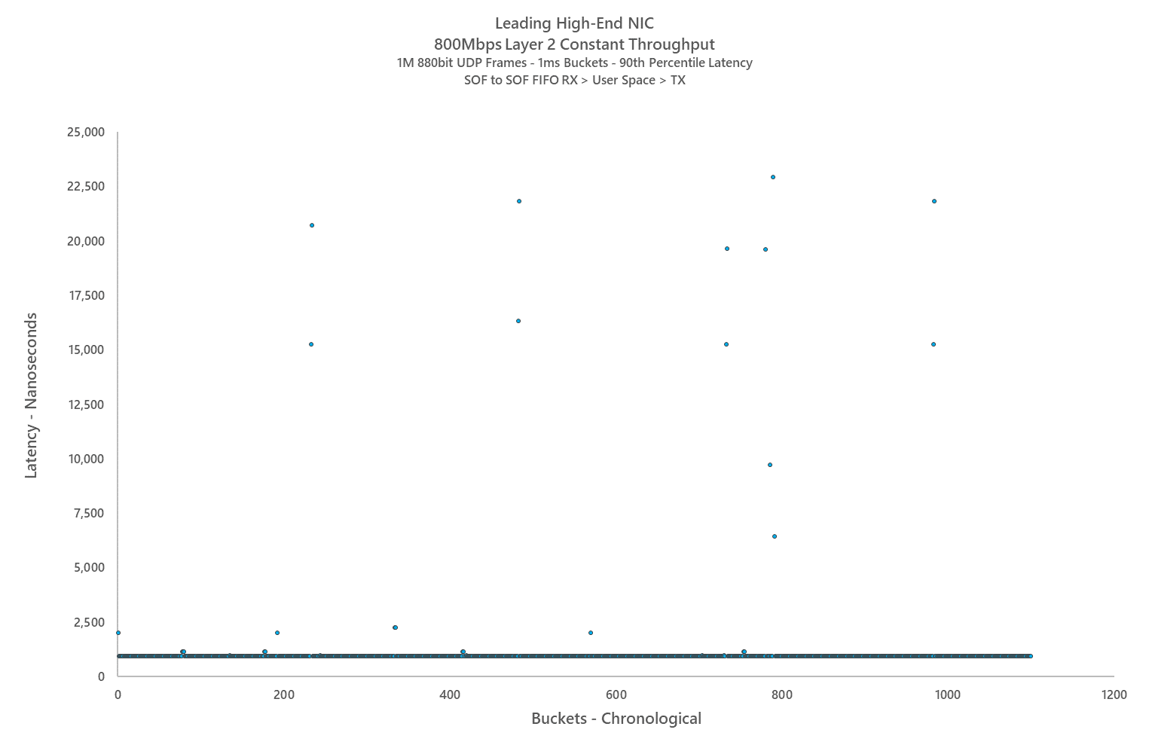
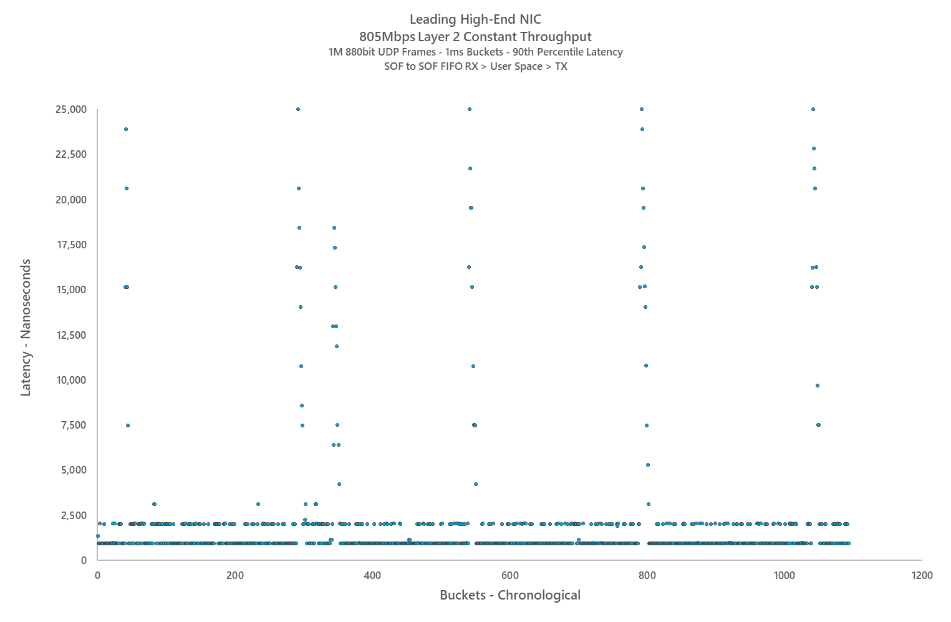
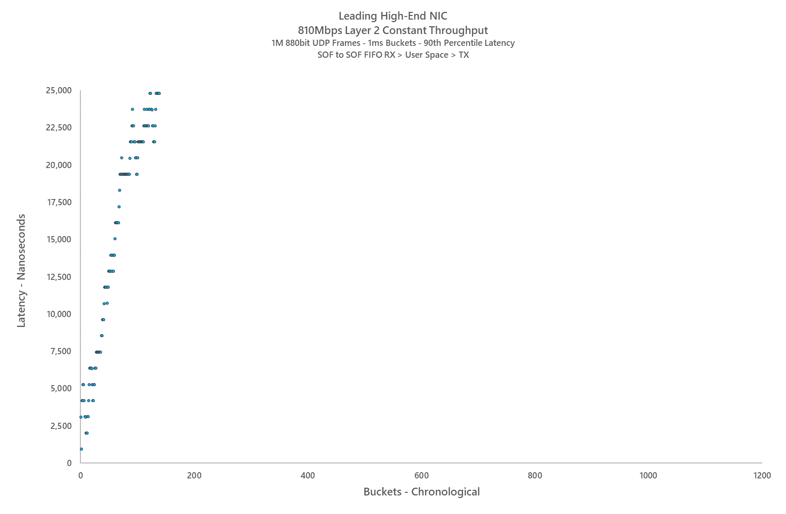
LMS
Testing Results – Leading High-End NIC @ 10GbE
LIQUID-MARKETS SOLUTIONS
The Power of the Possible™
Stable Performance <800Mbps
PCIe and Memory Challenges Exert Increasing Influence from 800Mbps:
Significant (20,000+ Nanosecond) Latency Spikes @800Mbps
Increasing Instability @805Mbps at Edge of Performance Envelope
Hopelessly Broken @810Mbps; Latency Approaching 300,000 Nanoseconds at Test End
Market Data Rates
Typically Exceed
1000Mbps…
Significantly Exceeding
High-End NIC Capabilities
© 2021 Liquid-Markets-Holdings Inc. All rights reserved.
Proprietary and Confidential – Not for Redistribution without Prior Written Consent
Notes:
So what is possible? CLICK
For investors, removing bottlenecks and reducing end to end latency to under 1000ns
Embracing simple plug and play solutions
And for the global banks, saving $50M pa while delivering the best of breed solution
Transition: So what really matters in terms of market connectivity? CLICK

Slide 19
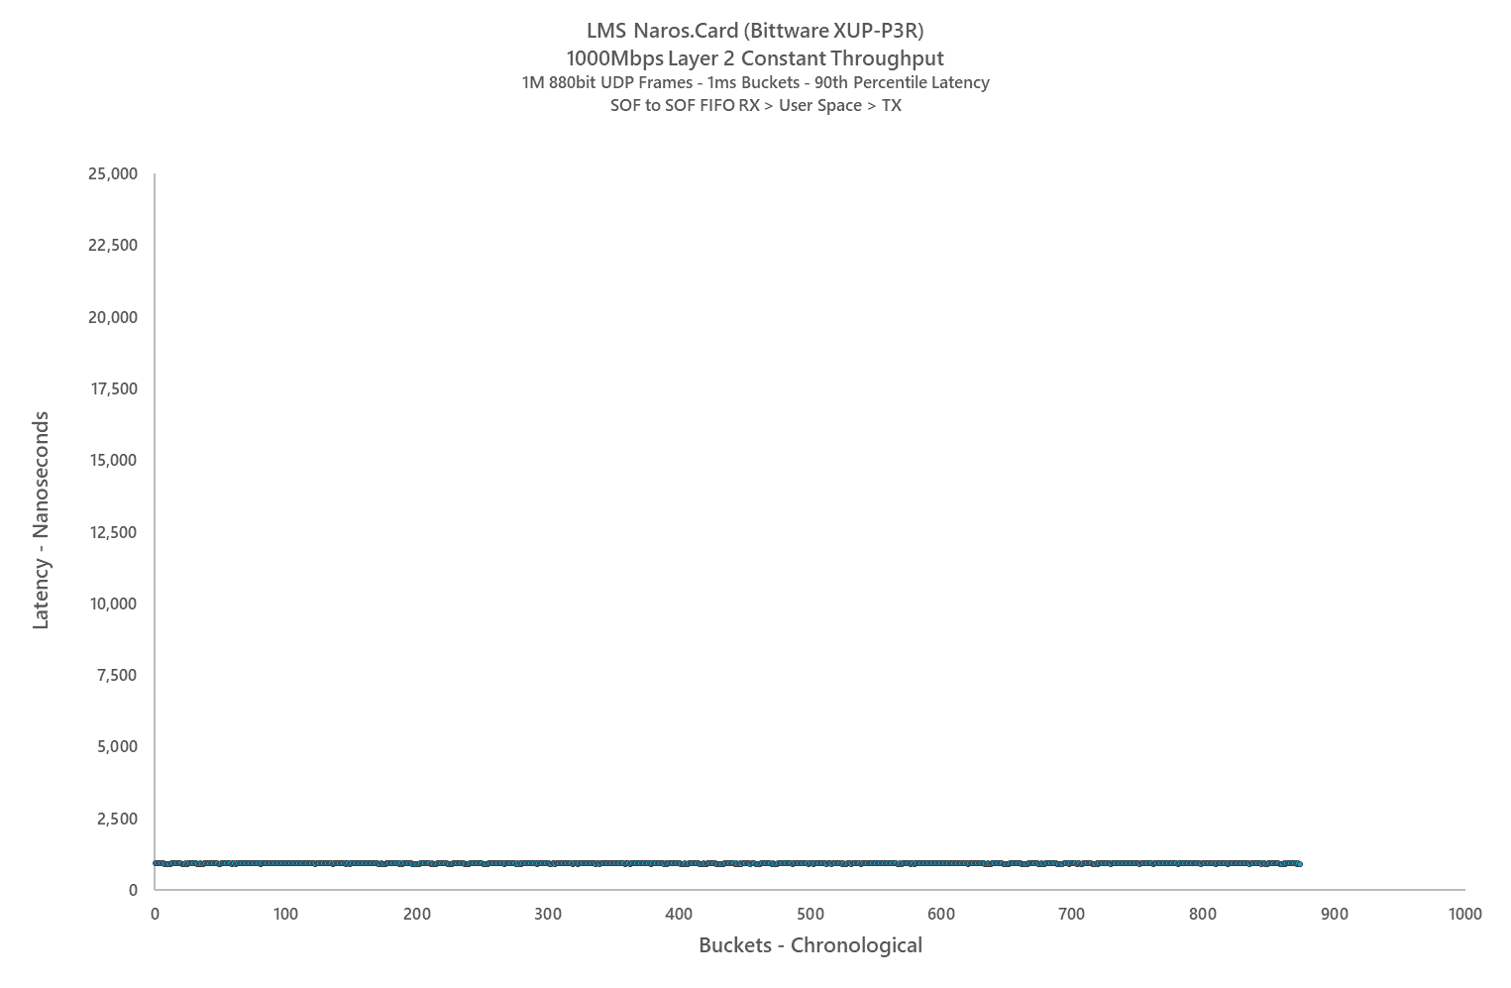
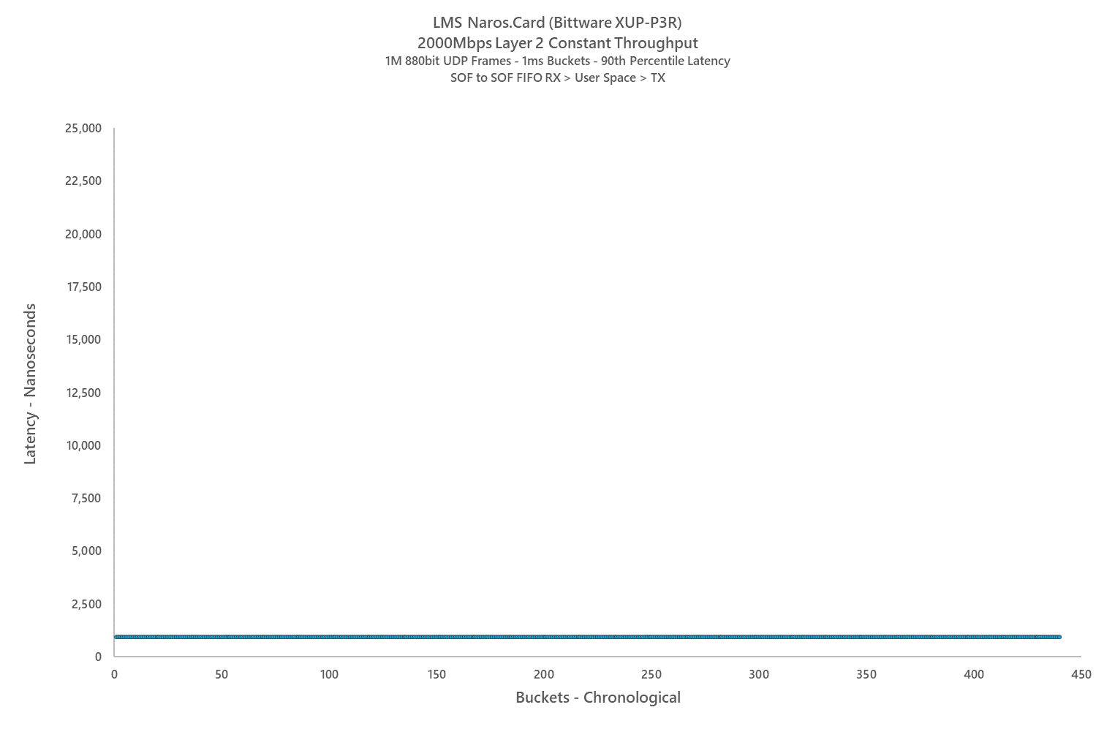
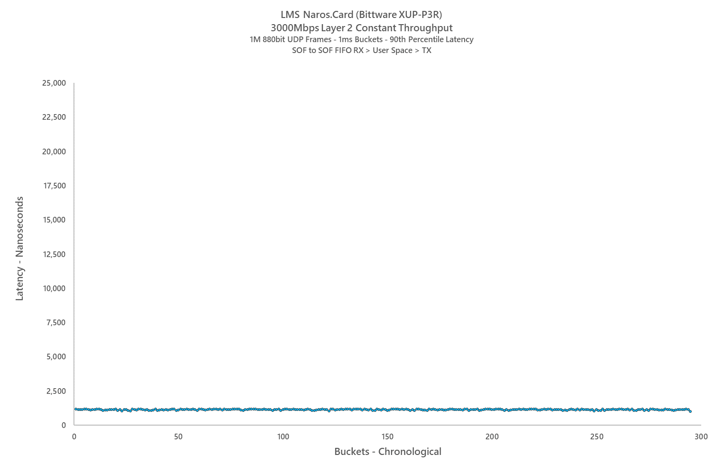
LMS
Testing Results – Naros.Card (Hybrid) @ 10GbE
LIQUID-MARKETS SOLUTIONS
The Power of the Possible™
Naros.Card™ (Hybrid) NIC…
Dramatically Expands
Capability
And
Headroom
Stable Performance <2850Mbps
PCIe and Memory Challenges Exert Increasing Influence from 2900Mbps:
Slight Jitter @3000Mbps But Performance Largely Stable
PCIe and Memory Challenges Present Terminal Obstacle @3100Mbps and beyond
© 2021 Liquid-Markets-Holdings Inc. All rights reserved.
Proprietary and Confidential – Not for Redistribution without Prior Written Consent
Notes:
So what is possible? CLICK
For investors, removing bottlenecks and reducing end to end latency to under 1000ns
Embracing simple plug and play solutions
And for the global banks, saving $50M pa while delivering the best of breed solution
Transition: So what really matters in terms of market connectivity? CLICK

Slide 20
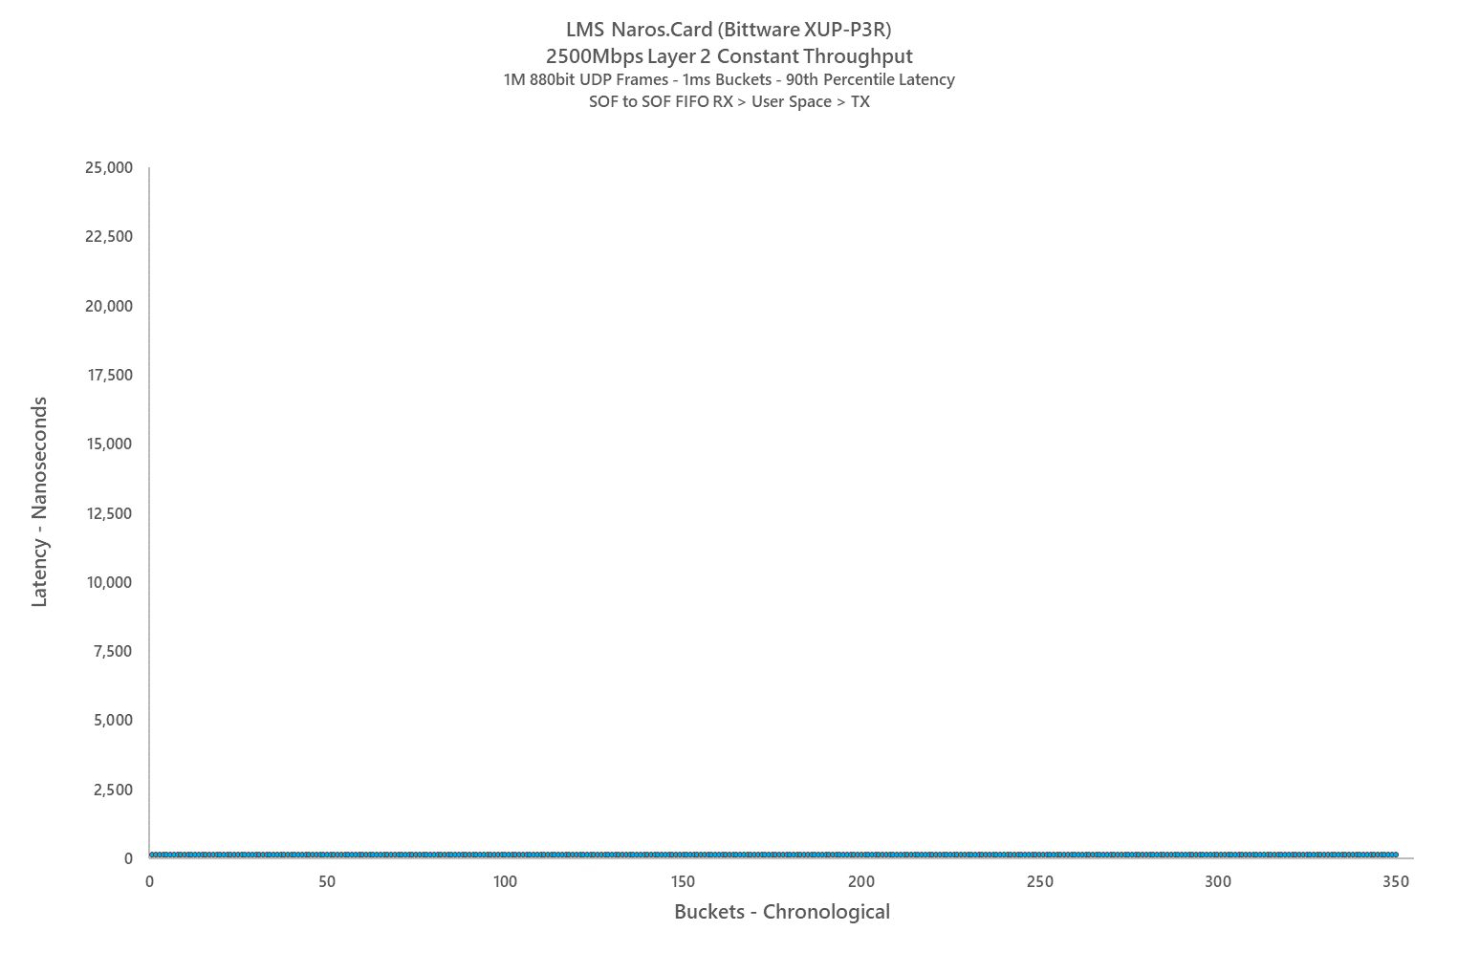
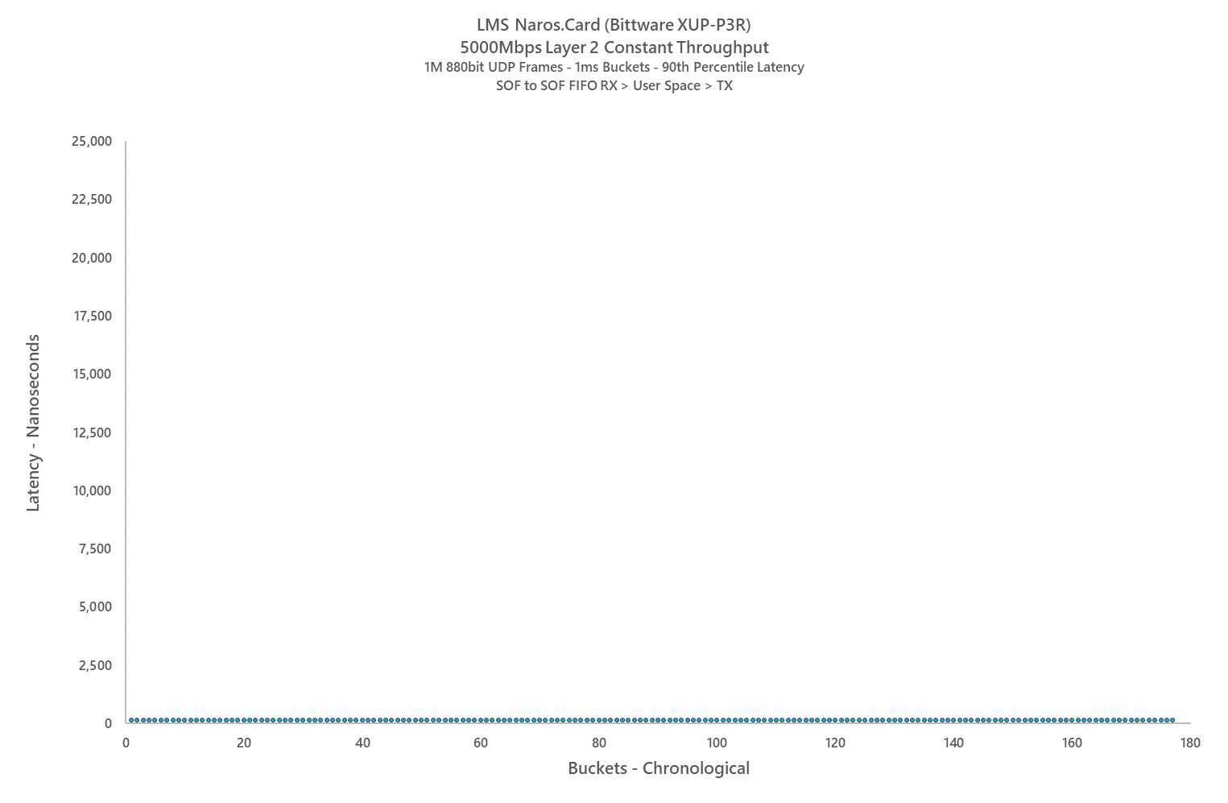
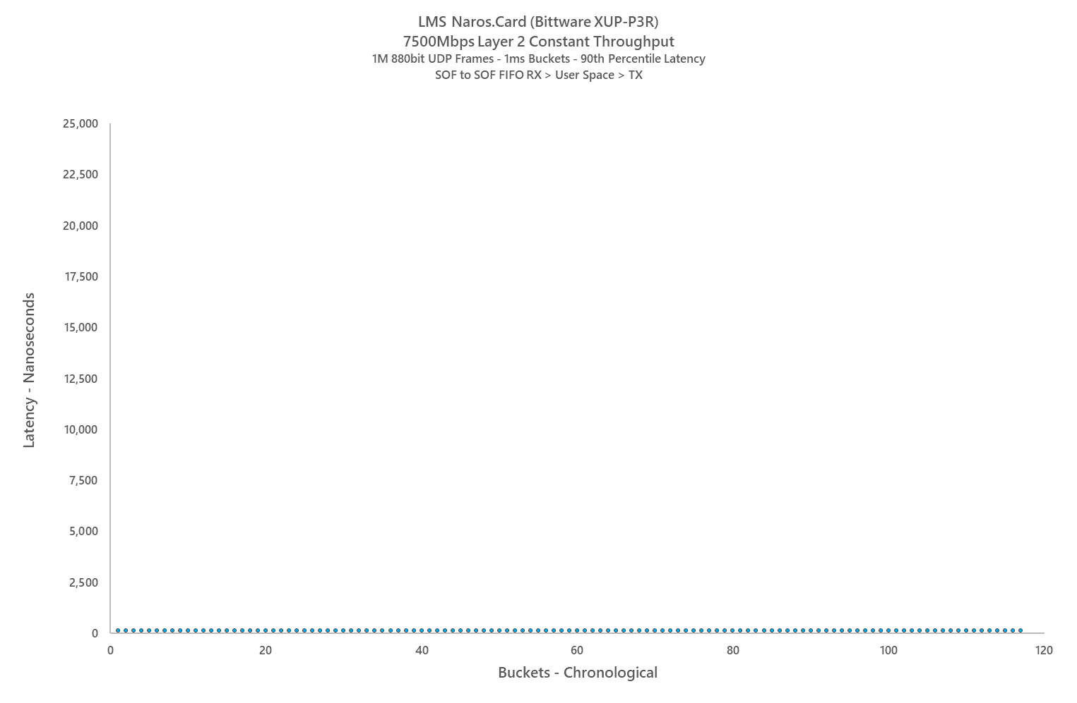
LMS
Testing Results – Naros.Card (Full FPGA) @ 10GbE
LIQUID-MARKETS SOLUTIONS
The Power of the Possible™
Naros.Card™
(Full-FPGA)…
Eliminates Constraints & Massively Empowers Processing
Stable Performance At All Testable Rates (TaSR Limited to 7500Mbps)
No PCIe and Memory Dependencies Exist in Full-FPGA Implementation
Like-for-Like Comparative Testing Demonstrates Latency Associated with x86-64 Architecture Issues Is Approximately 760ns to 840ns.
© 2021 Liquid-Markets-Holdings Inc. All rights reserved.
Proprietary and Confidential – Not for Redistribution without Prior Written Consent
Notes:
So what is possible? CLICK
For investors, removing bottlenecks and reducing end to end latency to under 1000ns
Embracing simple plug and play solutions
And for the global banks, saving $50M pa while delivering the best of breed solution
Transition: So what really matters in terms of market connectivity? CLICK

Slide 21
LMS
LIQUID-MARKETS SOLUTIONS
The Power of the Possible™
The Global Standard
Ultra-Low-Latency
&
Ultra-High-Capacity
Venue Access
&
Connectivity
lets.talk@liquid-markets.com
US: +1-212-784-6145
JP: +81-(0)50-5539-9608
SG: +65-8515-8557
© 2021 Liquid-Markets-Holdings Inc. All rights reserved.
Notes:
Thank you.

